Slide 1

Cricket Match(IPL) Winning Prediction Using ML
by
S . Mohammad Faraz
Roll No. 204G1A0558
G . Mounesh
Roll No. 204G1A0560
H. Bhagya Lakshmi
Roll No. 204G1A0519
C. Ganesh Kumar Reddy
Roll No. 204g1A0531
Under the guidance of
Mrs. P. Rohini M .Tech.
Assistant Professor
Department of Computer Science and Engineering
Srinivasa Ramanujan Institute of Technology
( Autonomus)
2023 - 2024

Slide 2

Contents
Abstract
Problem statement
Objectives of Project
Literature survey for first objective
Literature survey for second objective
Proposed Work -(Methods to be followed for proposed system)
References
GitHub Link
Queries

Slide 3
Abstract
The Indian Premier League (IPL), a globally acclaimed Twenty20 cricket tournament, serves as a captivating blend of athleticism, strategy, and fervent fan engagement.Our predictive engine generates precise predictions by examining a variety of variables including team performance, player form, pitch conditions, player stats and venue peculiarities. It does this by leveraging previous match data, intricate player statistics, and real-time dynamics , using python programing. The model shows robustness in match result prediction thorough validation and real-time adaption. This project contributes to responsible predictive analytics while increasing decision-making, strategic insights, and fan engagement within the IPL ecosystem by encouraging ethical considerations and upholding data protection policies.

Slide 4
Problem Statement
Match Outcome Prediction with Multivariate Analysis, Include a variety of factors and team composition.
Cross-Season Generalization , Adaptation and predictive framework that accounts for variations in team strategies, player dynamics, and external factors across different IPL seasons.

Slide 5
Objectives of Project
Transparency and Interpretability: One of the project's objectives is to offer forecasts that are clear and easy to grasp, enabling stakeholders to comprehend why a certain prediction was produced and the contributing elements.
Continuous Improvement: The project aims to improve the predictive model's accuracy through iterative updates using data from succeeding IPL seasons, making a contribution to the field of sports analytics and machine learning research
Engaging Fan Experience: The project seeks to enhance the fan experience by offering engaging insights and predictions about upcoming matches. Fans can engage in discussions, predictions, and analyses based on the model's outputs.

Slide 6
Literature survey for first objective
[1]The research paper helps to understand the different machine learning algorithms working principal and their implementation. Dataset is collected from various websites like ESPN, Kaggle, e.t.c .[1] Here we used three types of algorithms in this research to estimate the scores of the Indian Premier League, which is obviously a T20 format: Random forest, logistic regression , SVM(Support Vector Machine) .
[1]By training the models we'll get the accuracy of the dataset, that helps in giving fascinating outcome. This analysis is employed by the team for framing game-winning plans. In this the author shows that a much bigger information set will improve the accuracy of the prediction.

Slide 7
Literature survey for second objective
[2]This paper attempts to fulfil all those needs. From providing an interactive and user-friendly portal, which would provide very advanced functionalities in order to perform detailed exploratory analysis on all dimensions of matches, batsman, bowlers, etc.[2] To possess, the ability to rank players well, using the novel ranking approach and another one which is done using advanced techniques. It also possesses the feature to predict the outcome of a match, based on the players who are part of the current playing 11.
[2]Regarding the people who are interested in IPL cricket and are curious to explore its statistics as their past time.
[2]To help people with decision making, which team is stronger and has got higher chances of winning a match, and make them more enthusiastic

Slide 8
Literature survey for objective
[3] Technical paper which is given by K. Hiba Sadia, Aditya Sharma, Adarsh Paul, Sarmistha Padhi, Saurav Sanyal [4] on the topic “Stock Market Prediction Using Machine Learning predictions” where the major goal of this research is to establish the best model for predicting stock market value. Considering many strategies and variables that must be considered during the procedure, I've discovered that tactics such as random forest, support vector machines were not exploited fully.
[3]Every year, there is lots of hypothesis approximately who might win the Indian Premier League's famed title which the outcome may be changed in a matter of seconds using machine learning techniques such as SVM, Decision Tree , Random Forest and Logistic Regression to predict the winner.

Slide 9
Proposed System
To overcome the existing system, we will monitor the accuracy of the prediction and making users more enthusiastic by providing extra attributes like player stats ,we ourself are giving the rank to a particular player who is famous on particular aspect of play in order to improve the optimality in prediction.
The proposed system explains about the fervent fan engagement that by Allocating rating to players commensurate with their performance by the player stats , by using Random Forest regression classification, Decision tree classification and SVM(Support-Vector Machine) Classification either of them in order to built up the optimal accuracy compare to existing Projects and also to grab the attraction of users.

Slide 10
References
[1] A. I. Anik, S. Yeaser, A. G. M. I. Hossain and A. Chakrabarty, "Player’s Performance Prediction in IPL match" 2018 4th International Conference on Electrical Engineering and Information & Communication Technology (iCEEiCT), Dhaka, Bangladesh, 2018, pp. 500-505, doi: 10.1109/CEEICT.2018.8628118.
[2]Rupai, A. A. A., Mukta, M, & Islam, A.K.M.N., (2020). “Predicting Bowling Performance” in Cricket from Publicly Available Data. International Conference on Computing Advancements, 1-6.
[3]Swetha, Saravanan.KN, “Analysis on Attributes Deciding Cricket Winning”, International Research Journal of Engineering and Technology (IRJET), Volume: 04 Issue: 03 | (March 2017)

Slide 11
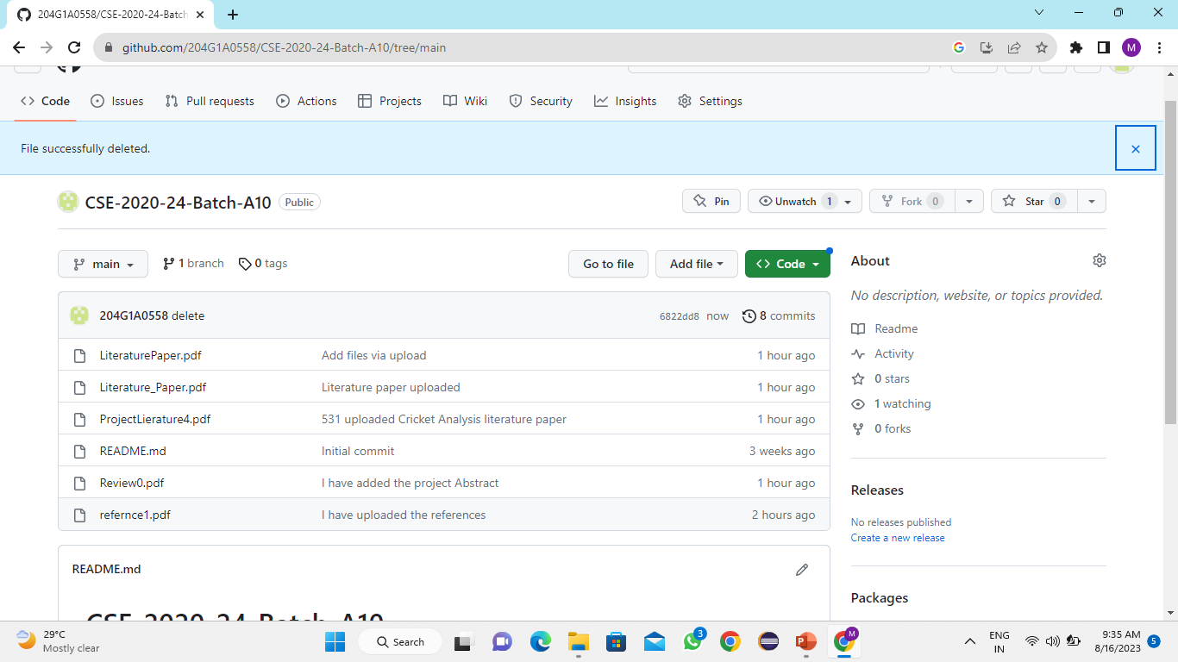
Git Hub Dashboards of each student
https://github.com/204G1A0558/CSE-2020-24-Batch-A10.git

Slide 12
Any Queries?

